Slide 1

CSE4014: TEAM SOFTWARE PROCESS
WEB BASED BILLING SOFTWARE
19BCE7490 - Sri Harsha
19BCD7024 - Meka Ujwala
19BCE7097 - Neha Chowdary
19BCD7050 - Khyathi Kommineni
19BCE7479 - Manju Bhargavi
18BCE7051 - K M K Nitesh Varma
Group-2
Guided By: Dr Mehfooza Munavar Basha

Slide 2
INTRODUCTION
This Web-based Billing Software (WBS) tool allows company owners to set up online bill management, consumers to read bills, and owners to save or download invoices for new businesses. It is developed on a network of department stores around the country.
Team Leader - Sri Harsha
Team Instructor - Meka Ujwala
Development Manager- Neha Chowdary
Support Manager - K M K Nitesh Varma
Quality/Process Manager - Manju Bhargavi
Planning Manager - Khyathi Kommineni

Slide 3
Why did you select TSP as the domain for your project?
Why is TSP a good choice for your project?

Slide 4
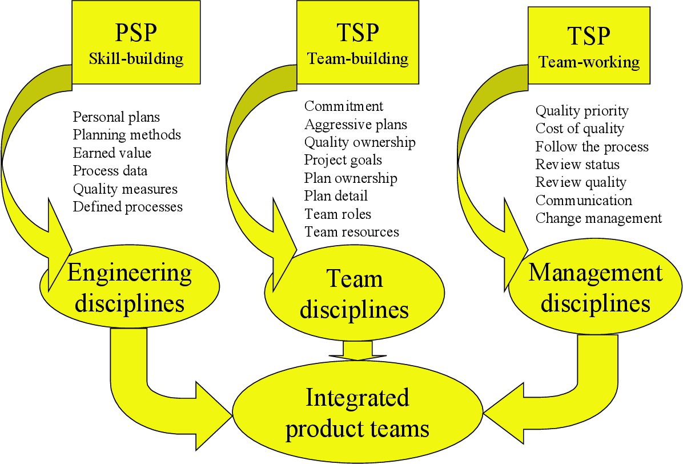
PERSONAL SOFTWARE PROCESS vs TEAM SOFTWARE PROCESS

Slide 5
CYCLE-1

Slide 6
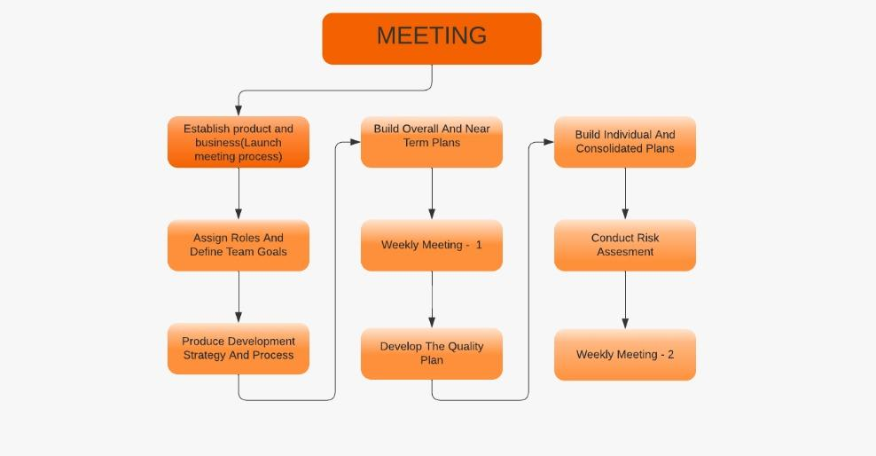

Slide 7

TEAM LEADER

Slide 8
Inputs
Boost my teammates confidence.
Have better time management.
Quickly and effectively resolve team conflicts.
Effective communication with team members.
Effectively facilitate team meetings.
Contributed to the development of the Account creation module.
Experience and Outcomes
Gaining industry level experience of leading a team.
Effective communication skills.
Able to resolve and manage conflicts within the team.

Slide 9

TEAM INSTRUCTOR

Slide 10
Inputs
Tracked the progress of the team.
Documented the project notebook.
Manage an effective team.
Getting project progress from the quality manager
Document all the TSPi process and make a report of the same.
Contributed to the development of the Bill generation module.
Experience and Outcomes
I gained a productive experience in taking the team forward in all the aspects of phases.
Was able to maintain a record of everything in a systematic manner.
Handling the project and delivering the product under pressure within the given time constraint.

Slide 11

DEVELOPMENT MANAGER

Slide 12
Inputs
Created a development strategy, led the team in the construction of an architectural diagram, and oversaw product implementation.
Interacted with the planning manager to create preliminary time and size estimates for the product.
Contributed to the development of the Bill Calculation Module and the Product Shorthand Notation Module.
Compiled the STRAT script for Cycle-1 .Revised the STRAT script for Cycle-2.
Verified SRS and SDS in accordance with the intended goals.
Implemented the product modules and played a significant part in testing them.
Worked mostly as a product developer and tester.

Slide 13
Experience and Outcomes
Gained an experience of working as development manager and leading the team throughout as a technical lead.
Greater insight on the development tools used in the project.
Collaborative working on the development and testing parts.
Was able to plan the optimized size and time estimates.

Slide 14

PLANNING MANAGER

Slide 15
Inputs
Lead the team in producing the task plan for the next development cycle.
Lead the team in producing the schedule for the next development cycle.
Identify workload imbalances among team members.
Lead the team in adjusting workload to achieve balance
Track the teams progress against the plan.
Report the personal and consolidated team status to the instructor.
Participate in producing the development cycle report.
Worked as a product development engineer.
Contributed to the development of the Report generation module
Experience and Outcomes
I have gained a logical experience and orderly mind and felt most comfortable working under a defined plan.
Demonstrated experience working effectively with team members
Effectively communicate through authentic conversations and effective listening.

Slide 16

QUALITY/ PROCESS MANAGER

Slide 17
Inputs:
Help team to give ideas and work on what they recommend.
My strategy was like following: Planning ,Improvement,Control ,Assurance .
Making sure of customer comfortability at every phase.
Helping the team in managing the backend process and provide info if they are lacking.
Improve performance in processes, decreases wastage, and promotes the value of time.
Making use of every team member to make product.
Making a keen observation at every project level.
Contributed to the development of the Logout module.
Experience and Outcomes.
Gained potential to manage a team and make work among them.
Came to know how to work in industries as a non_tech person.
Learn how to ask team to work again in soft manner if they did not make satisfy the customer level.

Slide 18

SUPPORT MANAGER

Slide 19
Inputs
Contributed to the development of the Admin module, Random giveaway generator module.
Conducted risk assessments and recommended changes for risks were made.
Ensured that the team has the necessary tools to complete the assignment.
Worked as a project developer.
Recommended latest technologies and methods to the development team.
Tracked new risks and maintained a record of the same.
Helped the development manager
Experience and Outcomes
Gained knowledge on the development tools involved in the project.
Was able to manage the tools required for the project and include them wherever required.
Research regarding the trending technologies.

Slide 20
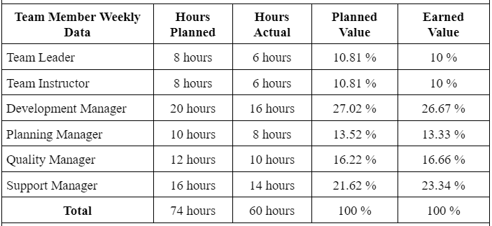

Slide 21
CYCLE-2

Slide 22
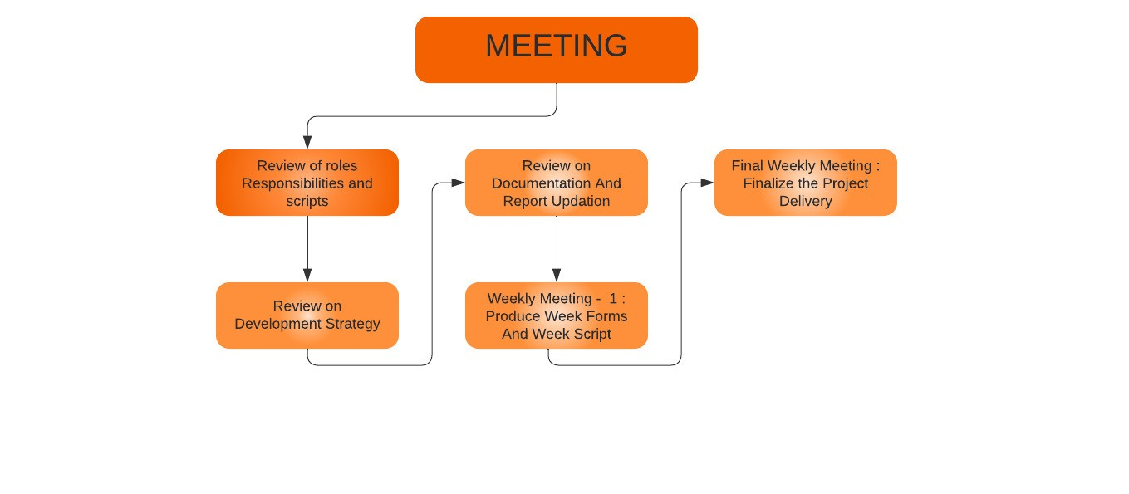

Slide 23
PLANNING MANAGER

Slide 24
Experience and Outcomes
Came to know how deal with large and complicated projects with team coordination.
L̥earn how to divide and make use of every person and their skill for product Destination.
L̥earn taking care of every action in the process of planning to avoid flaws.
Communicating done effectively.

Slide 25
QUALITY/ PROCESS MANAGER

Slide 26
Experience and Outcomes
Gained experience in understanding the customer needs and requirements to develop effective quality processes.
Was able to review specifications for products.
Understanding of quality control procedures and relevant legal standards.
Learned to be responsible and conscientious.
Gained experience in monitoring the details and results driven approach.
Effective in communicating with team members.

Slide 27
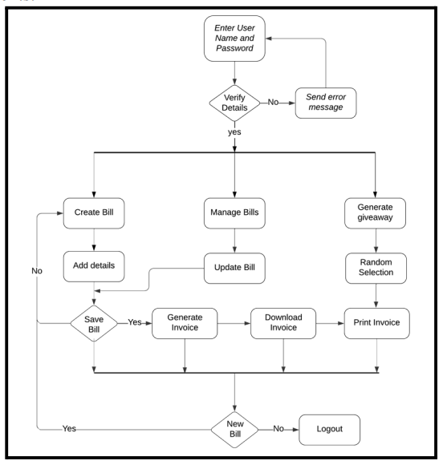
ARCHITECTURE DIAGRAM

Slide 28
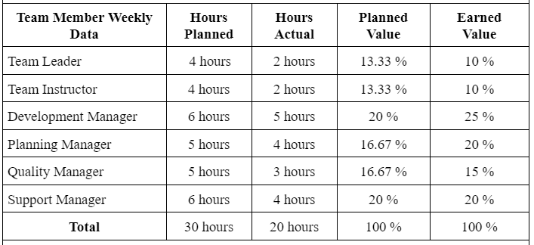

Slide 29
MODULE NAME | TEAM MEMBER ASSIGNED | ACTUAL HOURS | PLANNED HOURS
Account creation module | Talasila Sri Harsha | 7 hours | 6 hours
Bill generation module | Meka Ujwala | 8 hours | 6 hours
1) Bill calculation module 2) Product Shorthand notation module | B.Neha Chowdary | 7 hours 13 hours | 5 hours 11 hours
1) Logout module 2) Validation | Manju Bhargavi | 4 hours 8 hours | 2 hours 8 hours
Report generation module | Khyathi Kommineni | 10 hours | 8 hours
1) Admin module 2) Random giveaway generator module | K M K Nitesh Varma | 6 hours 10 hours | 4 hours 10 hours

Slide 30
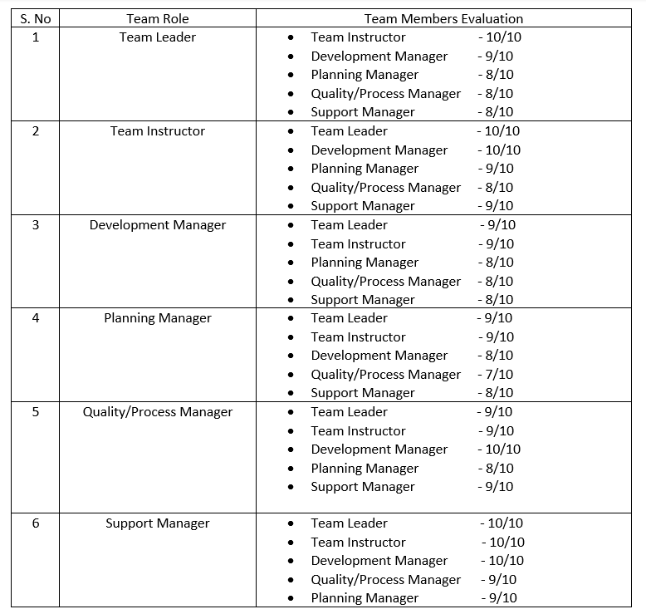
PEER EVALUATION

Slide 31
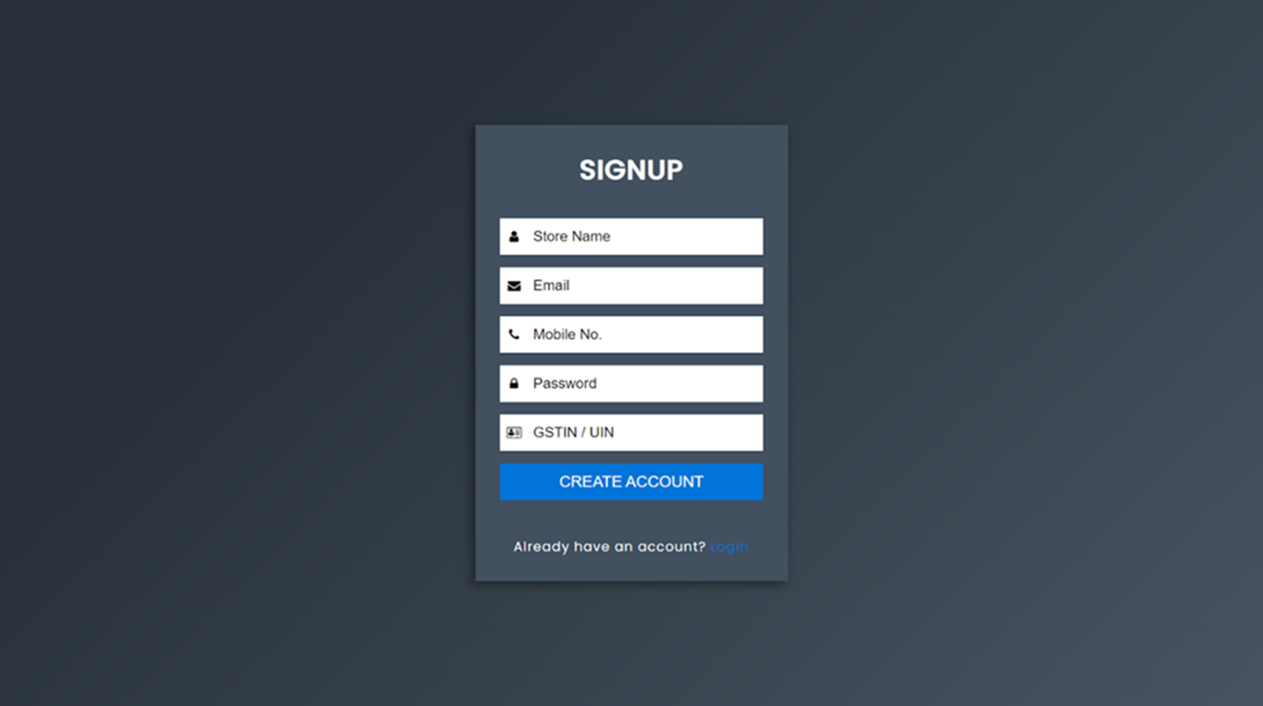
PROJECT SCREENSHOTS

Slide 32
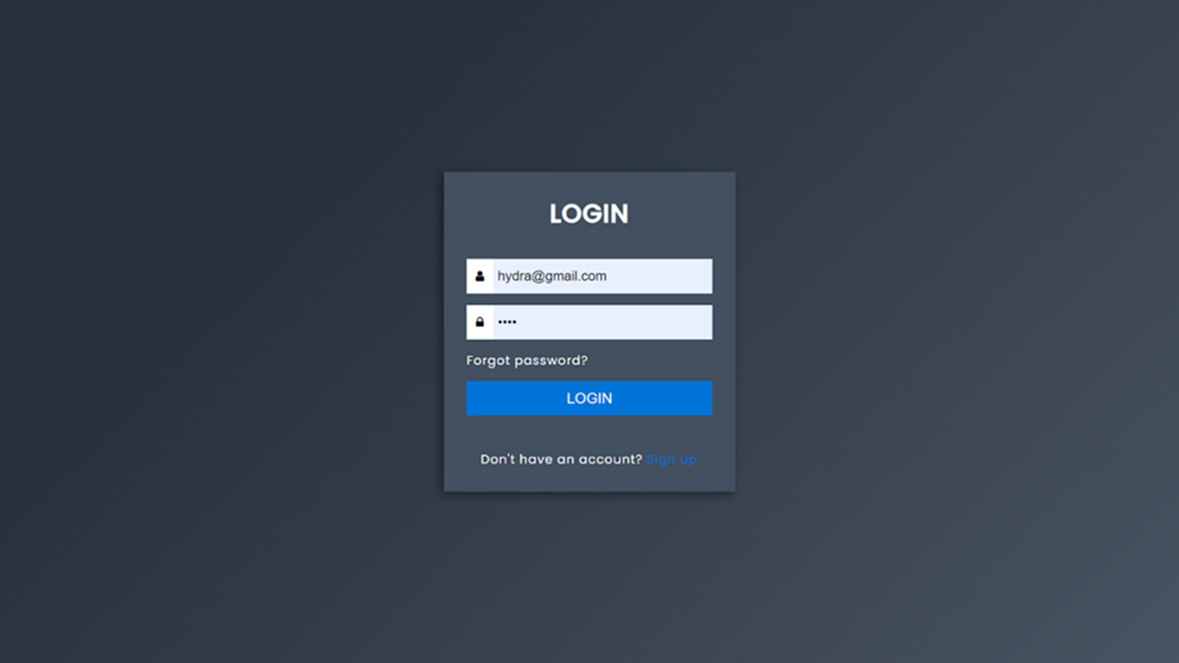

Slide 33
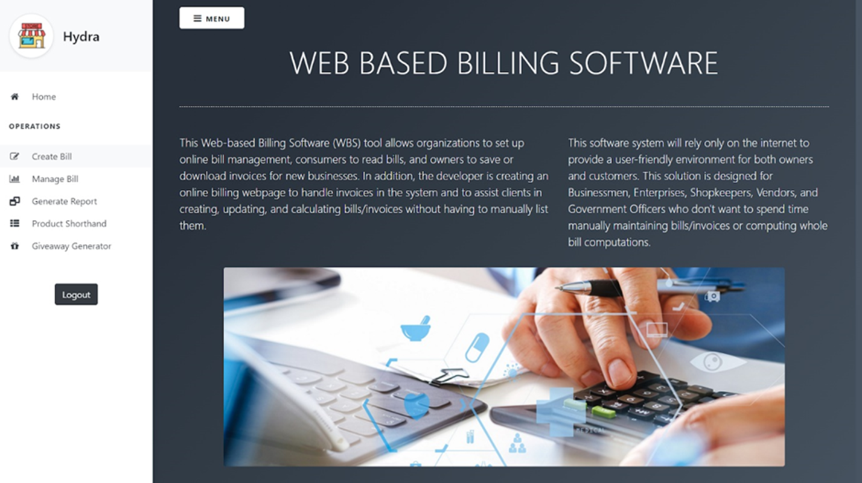

Slide 34
THANK YOU

